Slide 1
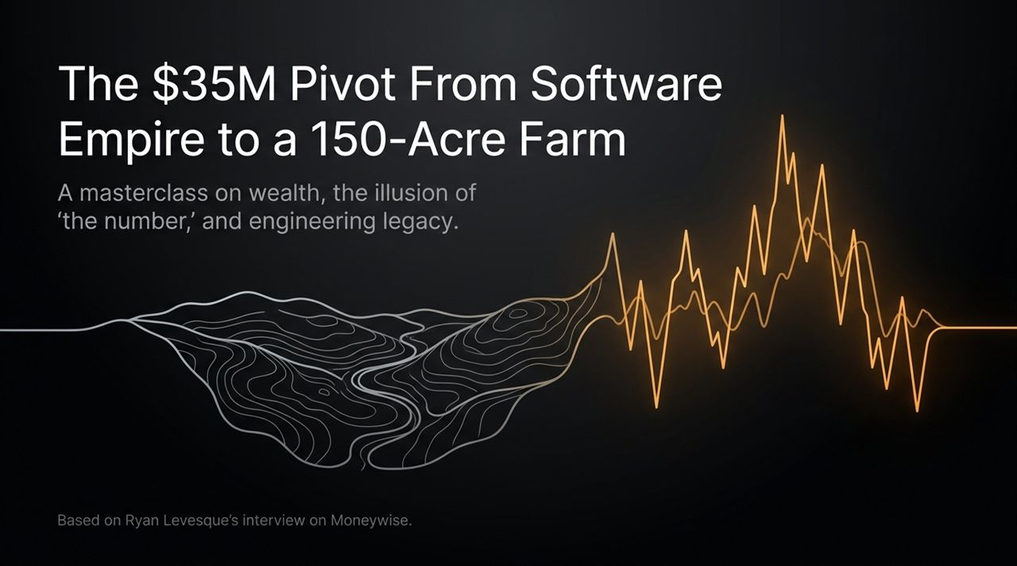
Notes:
Welcome, everyone. Today we are diving into a case study that sits at the exact intersection of financial strategy, human psychology, and legacy engineering. Title: 'The $35M Pivot From Software Empire to a 150-Acre Farm.'
This presentation is modeled directly after Ryan Levesque's interview on the Moneywise podcast. Ryan built a enterprise software empire generating well over $100 million in cumulative sales, only to walk away and completely redesign his life around a 150-acre homestead.
Over the next 15 slides, we aren't just going to look at the narrative of a founder leaving tech; we are going to break down the exact mathematics of net worth, the psychological traps high earners fall into, the mechanics of M&A deals collapsing, and the financial architecture required to fund intentional capital deployment. Let's jump in.
$35M Net Worth. Then He Traded It All for a 150-Acre Farm
https://www.youtube.com/watch?v=TZdwufg842Y

Slide 2
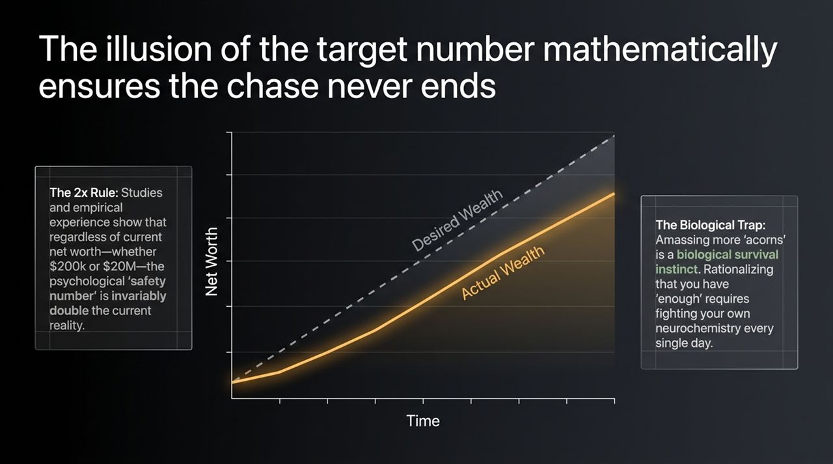
Notes:
Look at the chart on this slide. The solid line represents 'Actual Wealth,' and the dotted line above it represents 'Desired Wealth.' Notice how they never intersect.
Why is that? Because of a psychological phenomenon known as the 2x Rule. Empirical studies across ultra-high-net-worth individuals demonstrate that regardless of whether someone’s net worth sits at $200,000 or $20 million, their internal 'safety number'—the figure where they believe they can finally relax—is almost always double their current net worth.
This isn't just financial ambition; it's a Biological Trap. Our brains evolved in environments of scarcity. We are hardwired like squirrels amassing acorns for a winter that never ends. Rationalizing that you have 'enough' requires actively fighting your evolutionary neurochemistry every single day. Without explicit intervention, the target number dynamically shifts upward, ensuring the chase never mathematically finishes.

Slide 3
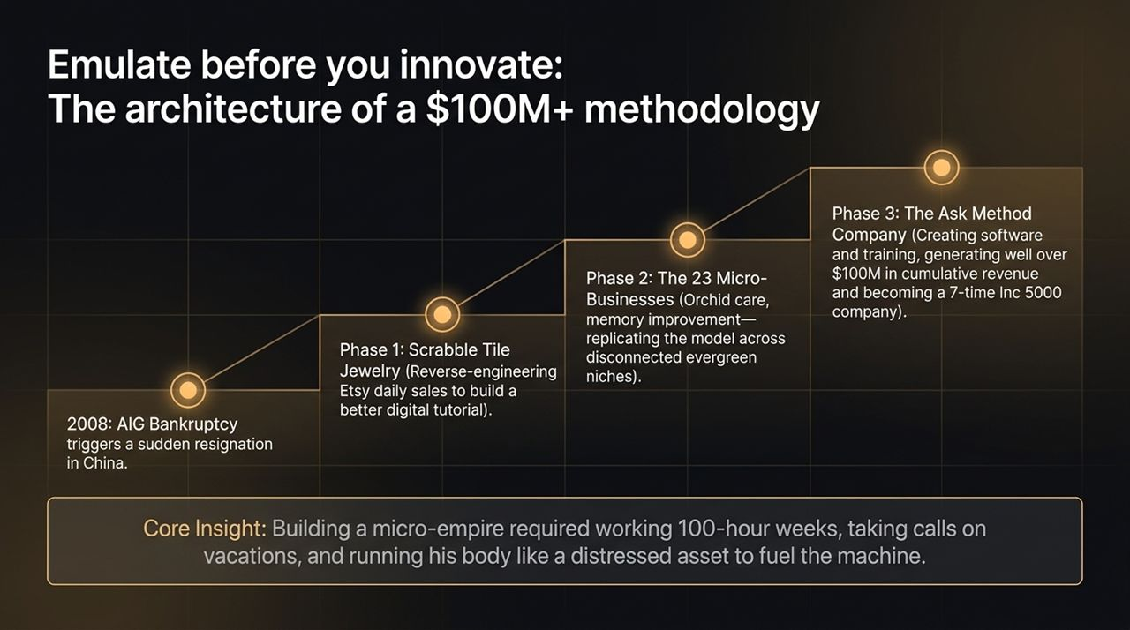
Notes:
Before we examine how Ryan broke out of this cycle, I want to anchor our perspective on this specific focal point.
In business, we are conditioned to constantly zoom out—looking at macro trends, market TAM, and multi-year scale. But breaking the 'more' cycle requires zooming in on the single inflection point where strategy meets personal reality.
Let's look at how Ryan built the foundation that made his pivot possible, starting with his early career trajectory.

Slide 4
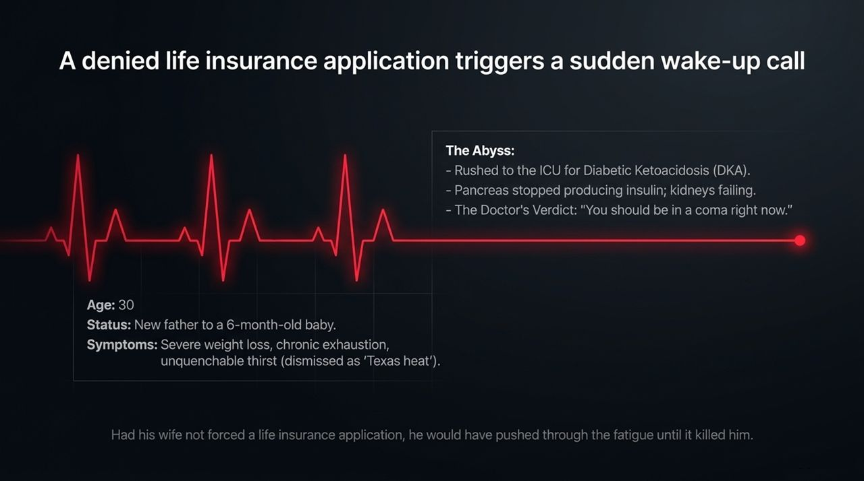
Notes:
Ryan didn't start with a high-flying tech company. His path was calculated using a framework called 'Emulate before you innovate.'
2008 & Phase 1: During the collapse of AIG while working in China, Ryan resigned and launched a business selling Scrabble tile jewelry tutorials. He didn't invent the market; he reverse-engineered daily sales on Etsy, saw where existing guides failed, and built a superior product.
Phase 2: He replicated this exact playbook across 23 distinct micro-businesses in evergreen niches ranging from orchid care to memory improvement.
Phase 3: This culminated in The Ask Method Company and its flagship software, generating over $100 million in cumulative revenue and landing on the Inc. 5000 list 7 times.
The Core Insight: Behind this success was extreme operational friction. Building this empire demanded 100-hour work weeks, taking customer calls during rare family vacations, and essentially treating his physical body like a distressed asset to power the growth engine.

Slide 5
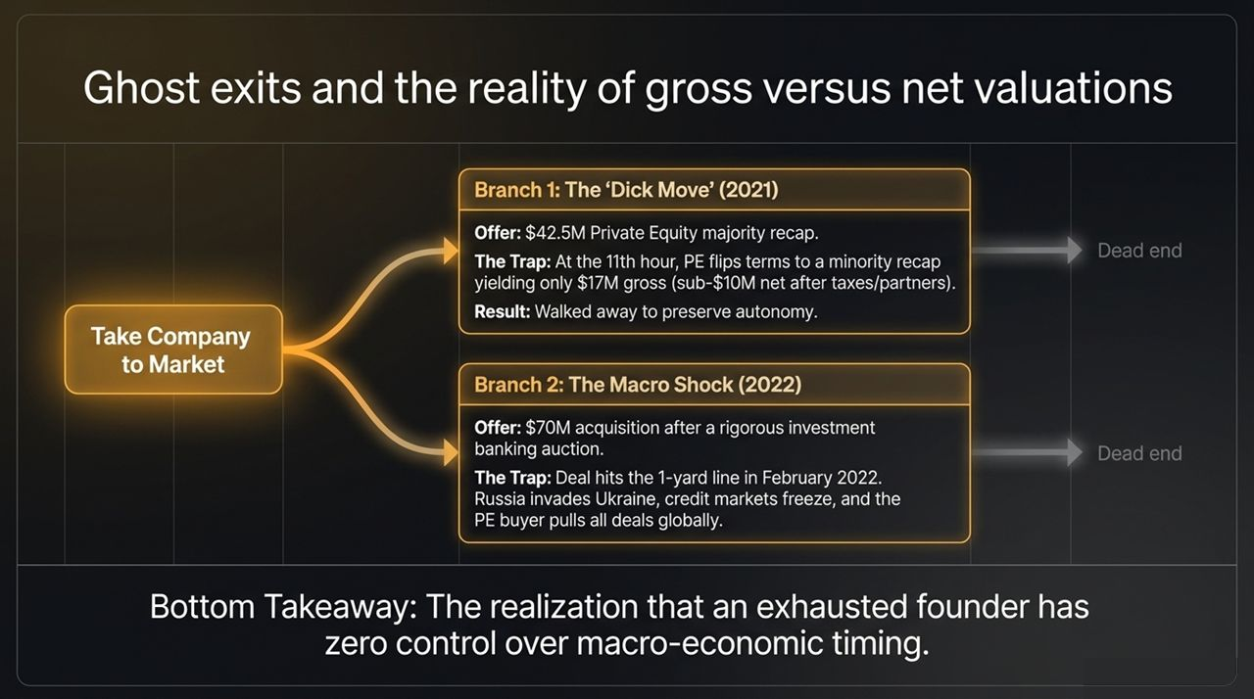
Notes:
At age 30, while running 23 micro-businesses, Ryan was a new father to a 6-month-old. He was suffering from chronic exhaustion, severe weight loss, and unquenchable thirst. He wrote it off as the 'Texas heat' and kept pushing through.
His wife eventually insisted he apply for life insurance. During the routine physical exam, his lab results caused a medical panic. He was denied coverage and rushed directly to the ICU.
Ryan was in severe Diabetic Ketoacidosis (DKA). His pancreas had stopped producing insulin, and his kidneys were actively failing. The attending doctor looked at him and said, 'You shouldn't be standing; you should be in a coma.'
Had his wife not forced that life insurance application, Ryan would have continued operating on pure adrenaline until his body shut down completely. This was his first major wake-up call that financial growth built on physical destruction is unsustainable.

Slide 6
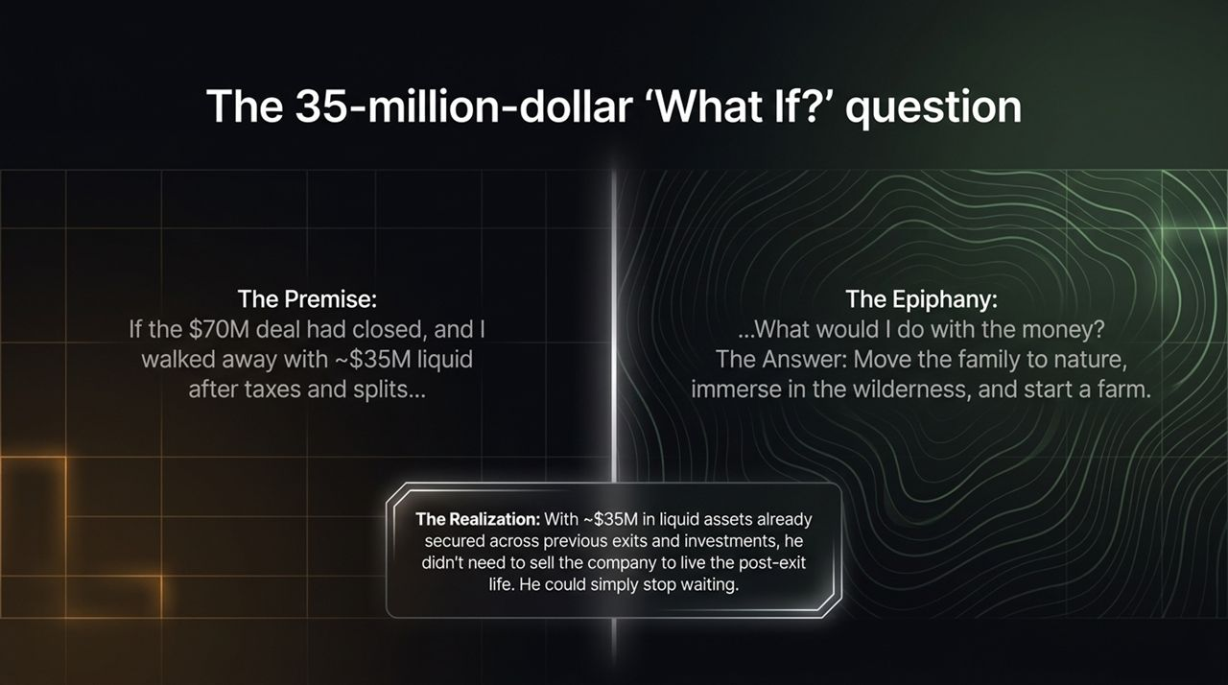
Notes:
Even after adjusting his operational pace, Ryan faced another harsh reality of entrepreneurship: the fragility of M&A.
Branch 1 (2021): A private equity firm offered a $42.5 million majority recapitalization. At the 11th hour, the PE firm restructured the deal into a minority recap. The gross payout dropped to $17 million, which translated to less than $10 million net after taxes and equity partners. Ryan walked away rather than give up control for an unfavorable deal structure.
Branch 2 (2022): Following an intensive investment banking auction, the company received a $70 million acquisition offer. By February 2022, the deal was on the '1-yard line.' Then, Russia invaded Ukraine, global credit markets froze, and the buyer pulled all private equity transactions worldwide.
The Takeaway: As a founder, you can build a flawless asset, but you have zero control over macro-economic timing. These two 'ghost exits' left him exhausted and forced him to reevaluate his entire timeline.

Slide 7
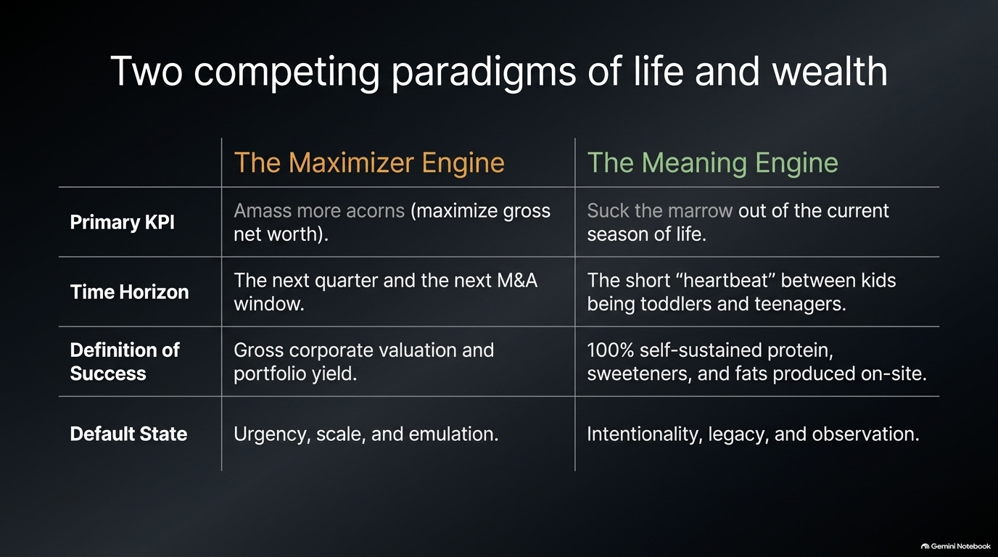
Notes:
After the $70 million deal fell apart, Ryan sat down to do a thought experiment.
The Premise: 'If that $70 million deal had gone through, I would have walked away with roughly $35 million liquid after taxes, fees, and distributions.'
The Epiphany: 'What would I actually do with that $35 million?' His answer was simple: Move his family out of the suburban grind, immerse them in nature, and start a self-sustaining farm.
The Realization: When he audited his existing liquid holdings from prior software dividends, exits, and real estate investments, he realized he already had access to the capital required to fund that lifestyle. He didn't need the $70M exit to unlock his post-exit life. He was holding himself hostage to a 'number' he didn't actually need.

Slide 8
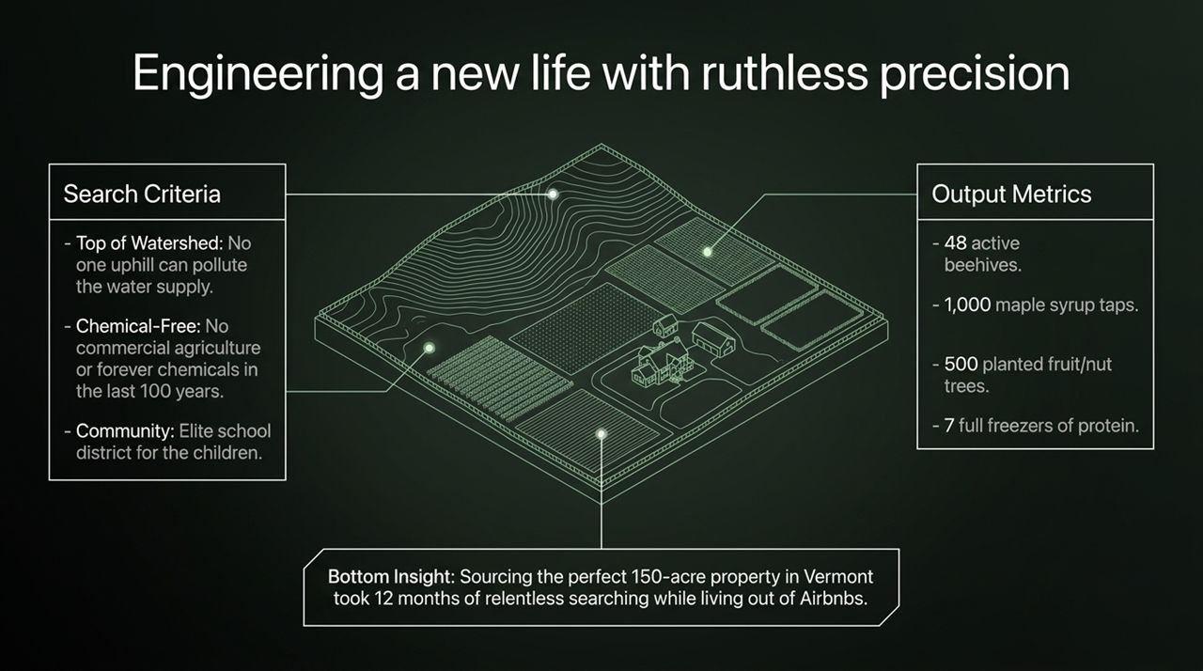
Notes:
This table contrasts two fundamental frameworks for viewing capital:
1. Primary KPI: The Maximizer Engine focuses strictly on net worth growth. The Meaning Engine focuses on extracting maximum value—'sucking the marrow'—out of the present season of life.
2. Time Horizon: The Maximizer plans around quarters and exit windows. The Meaning Engine plans around the narrow window between when kids are young children and when they become teenagers.
3. Definition of Success: Corporate valuation versus 100% self-sustained protein, sweeteners, and essential fats produced directly on-site.
4. Default State: Urgency and scale versus intentionality, observation, and legacy. Ryan shifted his operating system entirely to the right-hand column.

Slide 9
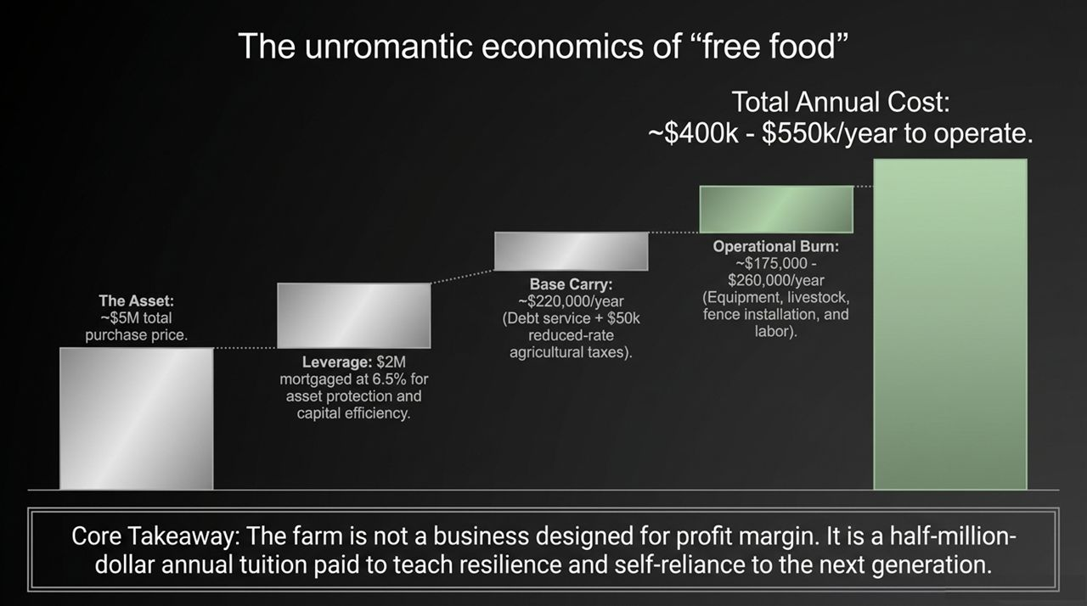
Notes:
When Ryan decided to execute this transition, he didn't view the farm as a passive hobby. He approached land acquisition with the same systematic engineering he applied to software development.
This layout represents the intentional zoning of his 150-acre property in Vermont. Every zone—from water sources to maple groves, orchards, and pastures—was designed to operate as an integrated system. Let's examine the criteria used to select this specific asset.

Slide 10
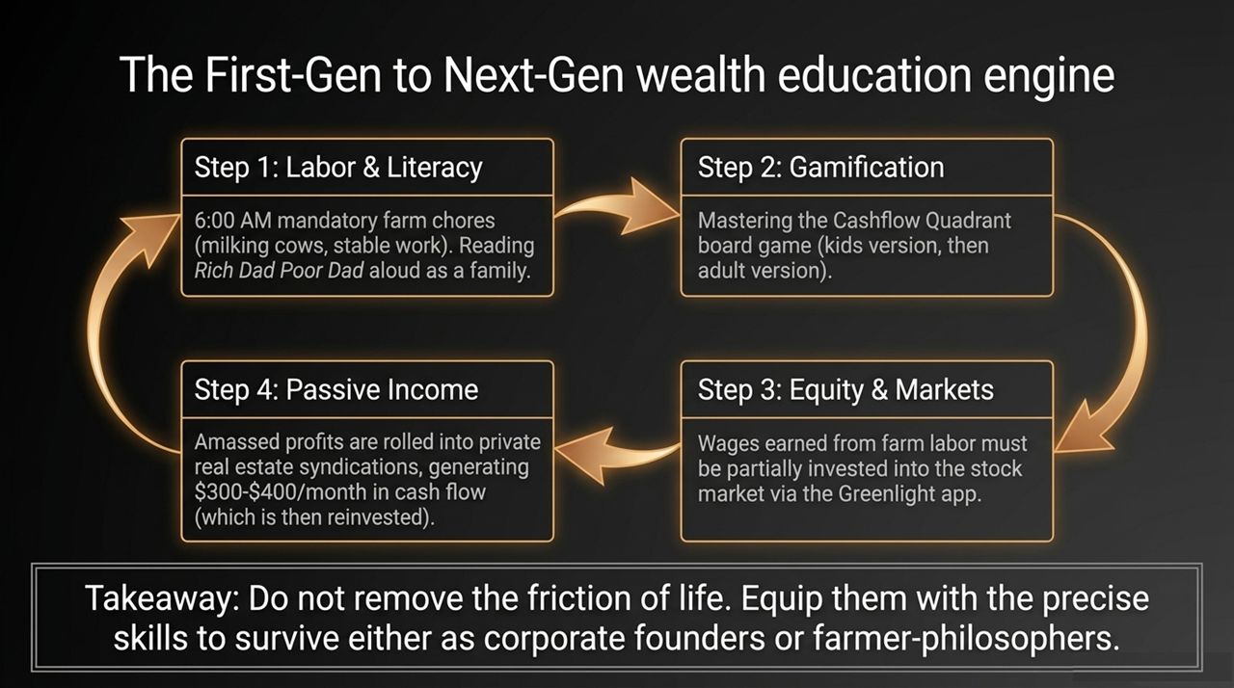
Notes:
To find the right property, Ryan spent 12 months searching while living out of Airbnbs, applying strict criteria:
Search Criteria:
*Top of Watershed: No upstream neighbors who could pollute the water supply.
Chemical-Free History: Land that had zero commercial agriculture or synthetic pesticide exposure for over 100 years.
Community: Proximity to top-tier local schools for his children.
Output Metrics: The resulting farm is highly productive:
48 active beehives.
1,000 maple syrup taps.
500 planted fruit and nut trees.
7 full freezers of home-raised protein.

Slide 11
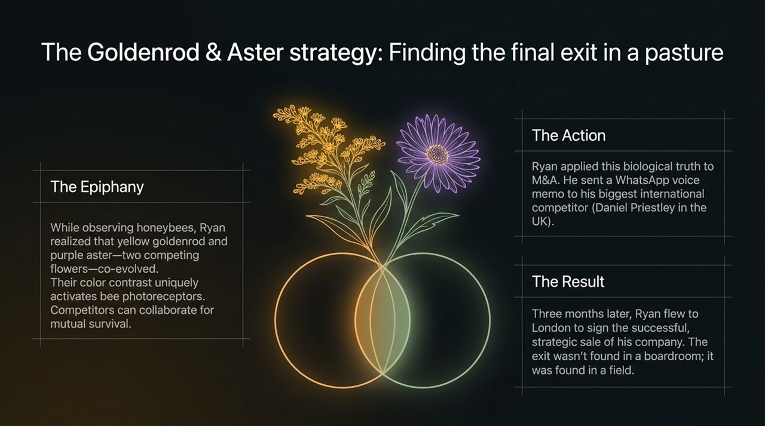
Notes:
Now, let's address the question most financial analysts and founders ask when looking at a setup like this: 'What are the actual economics of building a self-sustaining farm?'
As we will see on the next slide, the term 'free food' is a total misnomer.

Slide 12
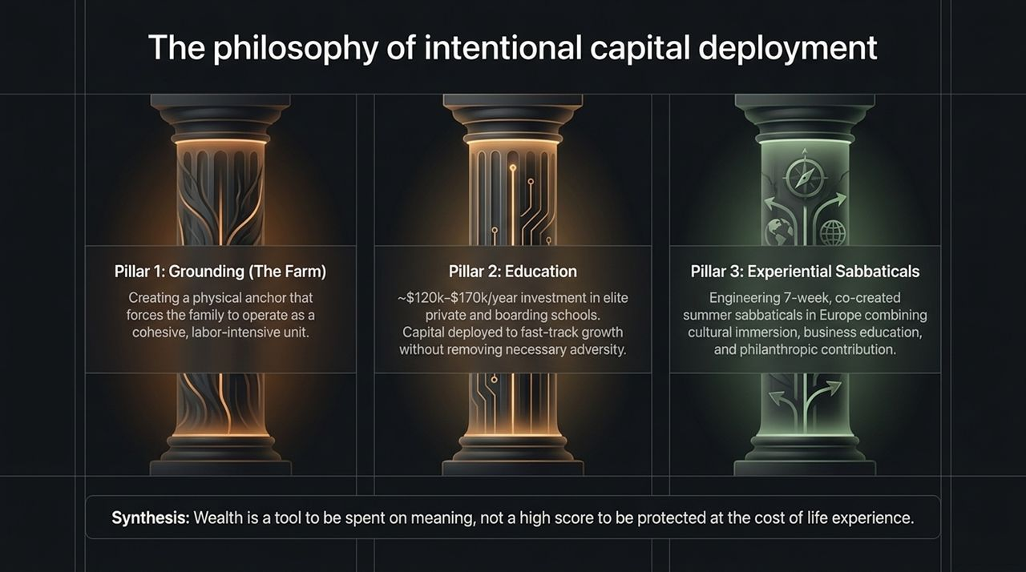
Notes:
Operating a self-sustaining luxury homestead is an expensive endeavor. Here is the exact financial breakdown:
Asset Cost: $5.0 million total purchase price.
Leverage Strategy: Rather than paying 100% cash, Ryan took out a $2.0 million mortgage at 6.5% interest. Why? To maintain liquidity and preserve asset-level liability protection.
Base Carry Cost: ~$220,000/year, covering debt service and $50,000 in discounted agricultural property taxes.
Operational Burn: ~$175,000 to $260,000/year for equipment, livestock, fencing, and farm labor.
Total Annual Carrying Cost: $400,000 to $550,000 per year.
Core Takeaway: The farm is not an income-generating asset. It is a half-million-dollar annual investment designed to teach self-reliance, work ethic, and operational resilience to his children.

Slide 13
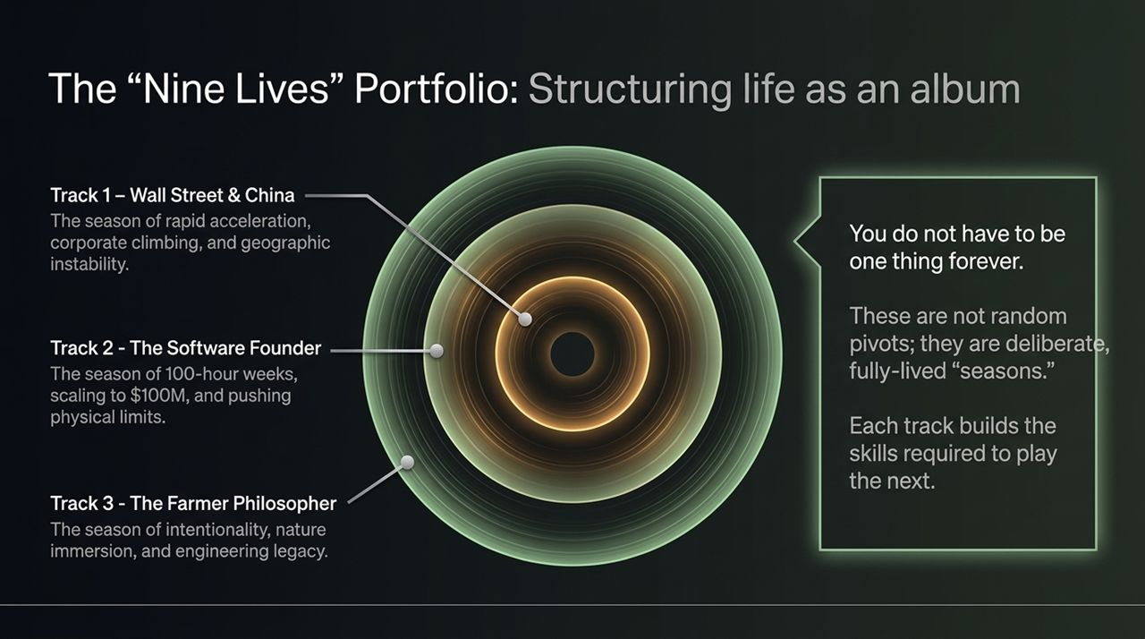
Notes:
How does Ryan turn that annual investment into human capital for his kids? Through a structured 4-step framework:
Step 1: Labor & Literacy: Mandatory 6:00 AM farm chores (milking cows, managing stalls) combined with reading financial classics like Rich Dad Poor Dad aloud as a family.
Step 2: Gamification: Playing the Cashflow Quadrant board game together, moving from the kids' version to the full adult version to build financial intuition.
Step 3: Equity & Markets: Earned farm wages cannot simply be spent. A fixed percentage must be allocated to stock market index funds via the Greenlight app.
Step 4: Passive Income: Once capital is built up, farm profits and saved wages are pooled into private real estate syndications. The kids currently generate $300–$400/month in passive cash flow, which is automatically reinvested.
The objective isn't to remove life's friction, but to equip them to navigate both corporate and practical environments.

Slide 14
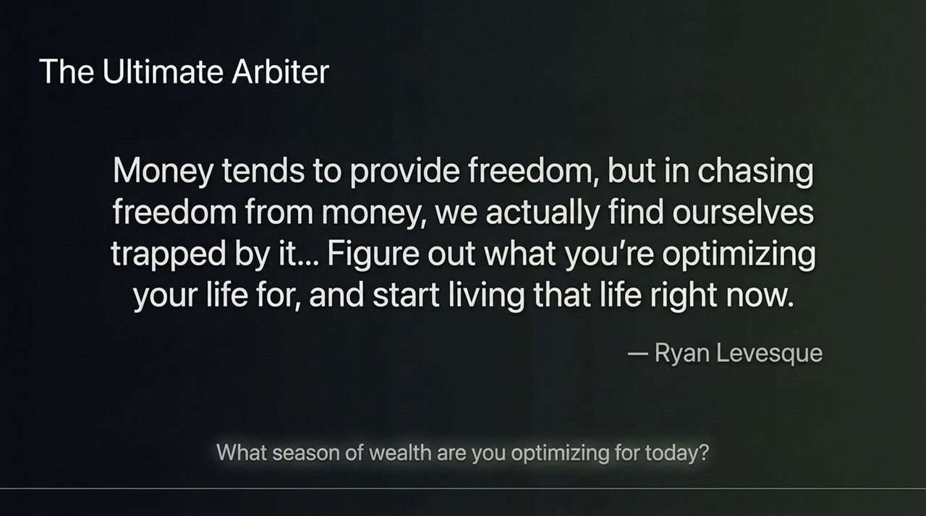
Notes:
We've covered the personal transition and the farm's operating model.
Now, let's look at how Ryan ultimately solved his original business problem: exiting his software enterprise.
Curiously, the solution didn't come from an investment banker; it came from observing nature on his farm.

Slide 15
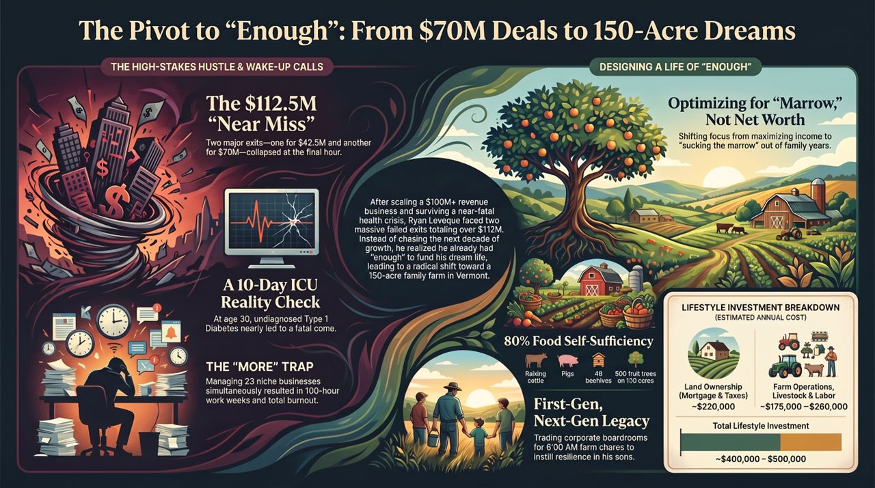
Notes:
While watching honeybees on his land, Ryan noticed something unique. Goldenrod (bright yellow) and Aster (bright purple) frequently grow side-by-side.
In plant biology, these two competing species co-evolved. The high contrast between yellow and purple activates bee photoreceptors far more effectively together than either flower can alone. By growing side-by-side, both species attract more pollinators and ensure mutual survival.
The Business Application: Ryan realized that direct corporate competitors don't always need to fight for market share; they can combine forces.
He sent a WhatsApp voice memo to his main global competitor, Daniel Priestley (based in the UK).
The Outcome: Three months later, Ryan flew to London and signed a strategic deal to merge and sell his company. The exit wasn't engineered in a traditional M&A boardroom—it was conceived by observing patterns in a pasture.
$35M Net Worth. Then He Traded It All for a 150-Acre Farm
https://www.youtube.com/watch?v=TZdwufg842Y

